Slide 1

The Many Faces of Sequence Data Processing
Tingjian Ge
University of Massachusetts, Lowell
ge@cs.uml.edu

Slide 2
Outline
Motivation and background
Semantics: what are we doing?
Algorithms: how to do it?

Slide 3
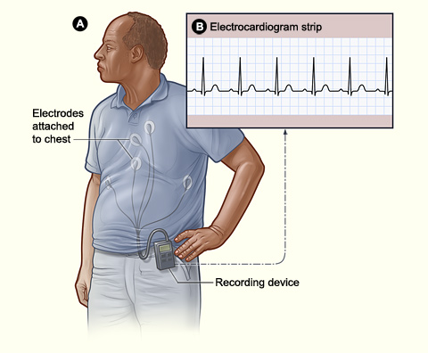
Motivating Applications
Holter Monitors
Sensors attached to chest of a heart-disease patient
Continuously monitor the ECG signals
Sent to a server through wireless communication

Slide 4
What is windowed subsequence matching?
. . . . . . d a t a i s e v e r y w h e r e . . . . . .
d a i r y
w = 11
“dairy” is a subsequence
It is a subsequence for a window size w ≥ 11
“dairy” is NOT a subsequence for window size w = 9
“diary” is NOT a subsequence for any window size w

Slide 5
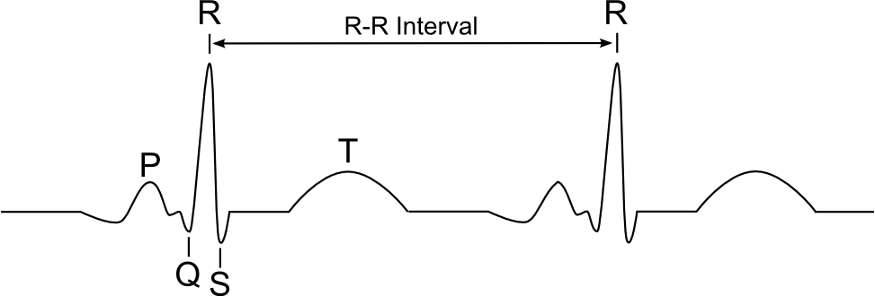
Motivating Application: Holter Monitors
3
2
1
0
……
0
1
0
3
0
0
1
1
1
0
0
0
0
1
0
3
0
……
0
R-R interval too short:
match p = 3003 with a small window size w1
R-R interval too long:
match p = 3003 with a large window size w2

Slide 6
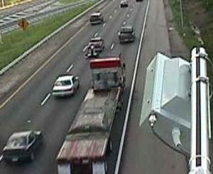
Motivating Application: Highway Monitoring
Scenario 1: finding close-by tailgaters.
Sensors can measure gaps between two cars.
T – truck tailgater, C – car tailgater, N – normal vehicles. We get a real-time sequence stream.
“Alert me when there are at least 5 truck tailgaters within a window of 20 vehicles.”
p = TTTTT, window size = 20.
Scenario 2: detecting a sudden traffic jam.
Sensors can estimate speed of vehicles passing by.
Discretized into 0 (<10 mph), 1 (10 to 30 mph), 2 (30 to 50 mph), 3 (> 50 mph)
p = 3210 within a certain window size – indicating a sudden slow down.

Slide 7
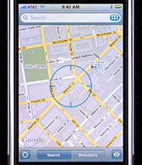

Motivating Applications: Smartphones and RFID
Location estimates using WiFi, GPS, …
Shopping mall: customer location + map = noisy stream of each customer’s visit sequence
A business owner’s query:
p = <restaurant, dessert shop, movie theater>
RFID on shopping cart: shopper’s shopping path
-- business intelligence
RFID on shelves, etc.: detecting shoplifting:
p = <shelf, not register, exit>

Slide 8
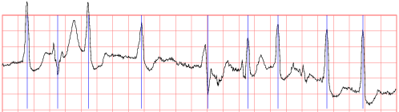
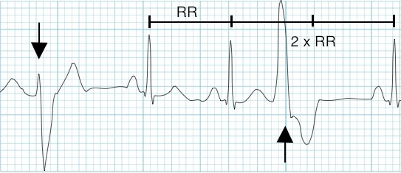
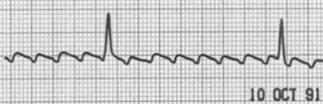


Generalization: Regular Expression & Correlated Errors
A noisy ECG piece from a real dataset
Atrial Flutter (AF)
Premature Ventricular Contraction (PVC)
$$r_{1}=\left(5 | 6\right)0{\left[\left(\overline{5}\overline{6}\right)1\left(\overline{5}\overline{6}\right)0\right]}^{3+}(5|6)$$
$$r_{2}=\left[−6 \left(3\left|4\right|5\right)\right] | [6 \left(−3\left|−4\right|−5\right)]$$
Notes:
Lets see an example, ECG M of heart disease. As we can tell, this is a very noisy ECG piece from a real dataset.
The second figure is the ECG pattern of Atrial Flutter, one kind of abnormal heartbeat. So a doctor might be interested in monitoring this AF pattern on a patient in real time.
One way to do the matching is to discretize the stream into several integer levels for example 7 levels from 0 to 6. Then the AF pattern can be expressed using such a regular expression. The work is to match such a regular expression pattern over a noisy integer stream.
The author of this dataset mentioned that the major noise sources of ECG include baseline drift and muscle tremor. Both of which create local positive correlation of noise.
Given this example. It’s not hard to tell that we will need two parts to solve this matching problem, the first one is a good noise/error measurement model and the second one is an efficient and effective matching algorithm that produces probabilities of matching.
Event pattern matching is sensitive to the noise or uncertainty in data.
map the observed data or events to characters in some alphabet, and then resort to regular expression matching [19, 1, 27] for finding patterns in a dynamically growing string that corresponds to the original stream. Clearly, if some crucial characters in the sequence are different from what they should be due to noise or incompleteness, an exact regular expression matching will fail to find the pattern.
Major noise source of ECG include baseline drift and muscle tremor, both of which create local positive correlation of noise. Which can be naturally represented by Markov Chain Error Model
Two abnormal ECG patterns [30] and an actual ECG piece with noise. (a) Atrial Flutter (AF). It has a signature "sawtooth" pattern, showing many sawtooth-like waves between two peaks. (b) Premature Ventricular Contraction (PVC). The arrows indicate two different kinds of abnormal shapes. (c) A noisy ECG piece from a real dataset.

Slide 9
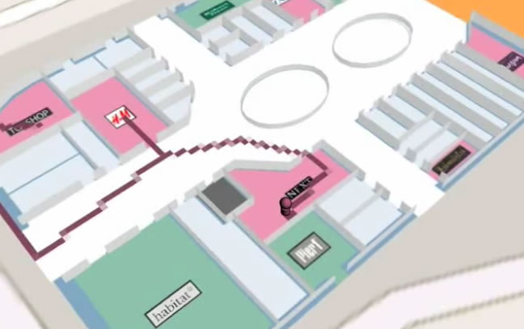




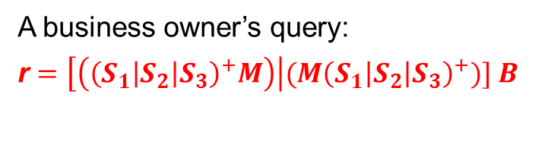
Example: Shopping Mall
$$S_{2}$$
$$S_{1}$$
$$S_{3}$$
$$M_{}$$
Shopping mall: customer location + map = noisy stream of each customer’s visit sequence
A business owner’s query:
r $=\left[\left({\left(S_{1}\left|S_{2}\right|S_{3}\right)}^{+}M\right)\right|(M{\left(S_{1}\left|S_{2}\right|S_{3}\right)}^{+})] B$
Notes:
This is another example. In a shopping mall, customers’ locations (estimated from their smartphones’ GPS or WiFi) combined with a map give a noisy stream of each customer’s visit sequence.
This provides valuable information for business intelligence
For example, the shoe department manager at Macy’s might be interested in this event “a customer visited other shoe stores in the mall as well as Macy’s and eventually decided to buy shoes at Macy’s”. Suppose there are three shoe stores $S_{1}$, $S_{2}$, and $S_{3}$. Then we can use this regular expression pattern r to denote this event:
$r_{3}=\left[\left({\left(S_{1}\left|S_{2}\right|S_{3}\right)}^{+}M\right)\right|(M{\left(S_{1}\left|S_{2}\right|S_{3}\right)}^{+})] B$
Where M means the customer visited Macy’s and B means he bought shoes at Macy’s S1 to S3 means he visited the other shoe stores S1 to S3.

Slide 10
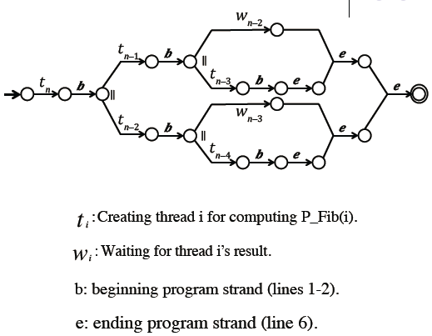
Testing & Debugging Parallel Programs
P-Fib(n)
1 if n≤1
2 return n
3 else x← spawn P-Fib(n-1)
4 y← spawn P-Fib(n-2)
5 sync
return x+y

Slide 11
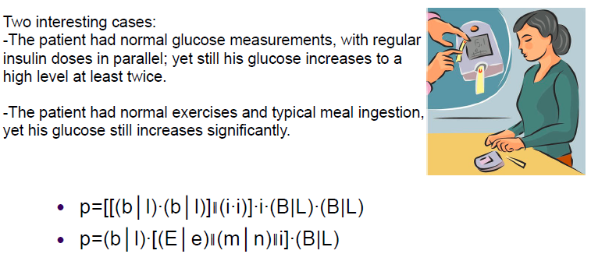
Diabetic Patient Logs

Slide 12
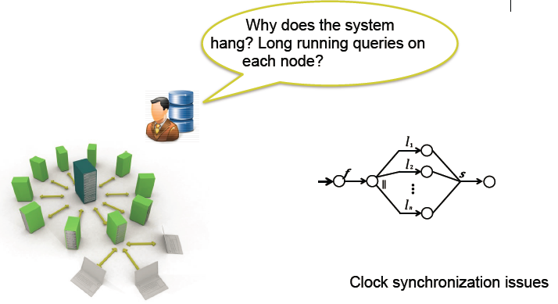
Monitoring Distributed Databases

Slide 13

Graph Streams – Road Networks
(M)
cong.
(M)
D
C
cong.
DC
CA
A
B
(M)
cong.
(M)
AB
$w=5$ minutes
F
E
cong.
FE
EA
(M)
cong.
(M)
(a)
(b)
(c)
smooth(5)
(M)
smooth(5)
(M)
(M)
(M)
smooth(3)
smooth(3)
cong.(4)
cong.(2)
cong.(1)
cong.(4)
cong.(2)
cong.(1)
(M)
(M)
(M)
(M)
(M)
(M)
(M)
(M)
cong.(6)
(M)
cong.(8)
(M)
(d)
(e)

Slide 14
Graph Streams – Social Networks
C₁
C₂
P₁
P₂
P₃
P₄
P₅
P₆
LinkedIn Streams
Twitter Streams

Slide 15
Graph Streams – Telephone Call Networks
P
P
P
P
P
P
L
L
L
L
C
C
C
C
C
C

Slide 16
Outline
Motivation and background
Semantics: what are we doing?
Algorithms: how to do it?

Slide 17
Windowed Subsequence Pattern
. . . . . . d a t a i s e v e r y w h e r e . . . . . .
d a i r y
w = 11
“dairy” is a subsequence
It is a subsequence for a window size w ≥ 11
“dairy” is NOT a subsequence for window size w = 9
“diary” is NOT a subsequence for any window size w

Slide 18


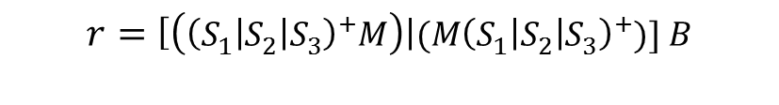

Extended Regular Expression Pattern
Free insertion
Window constraint
Negations
$$r=\left[\left({\left(S_{1}\left|S_{2}\right|S_{3}\right)}^{+}M\right)\right|(M{\left(S_{1}\left|S_{2}\right|S_{3}\right)}^{+})] B$$
w = 7
${ S}_{3} M$ $B$
This is a match in a window of size 7
. . . . . . $M S_{1}S_{3}S_{4}M{ S}_{7} S_{5} B S_{6}$ . . . . . .
$$M{ S}_{1} B$$
This is not a match in a window of size 7
w = 7
Noisy sequence:
Probability of matching
Notes:
We introduce ERE. An extended regular expression (ERE) matching is a regular expression matching extended by allowing mixing in irrelevant characters in the matching sequence, and augmented with window and negation constraints

Slide 19
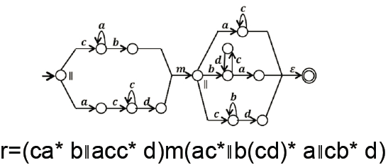
Parallel & Interleaving Events (PIE)

Slide 20
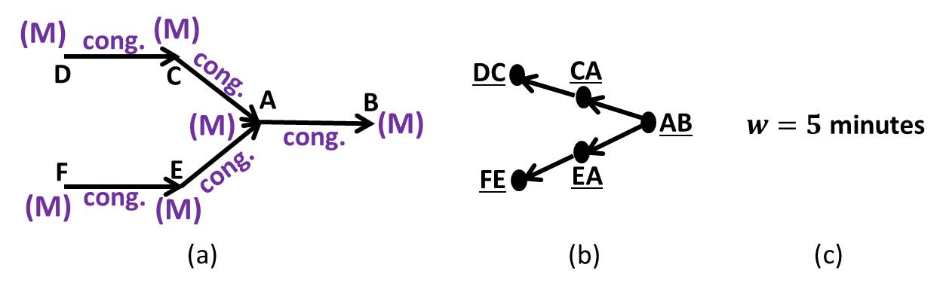
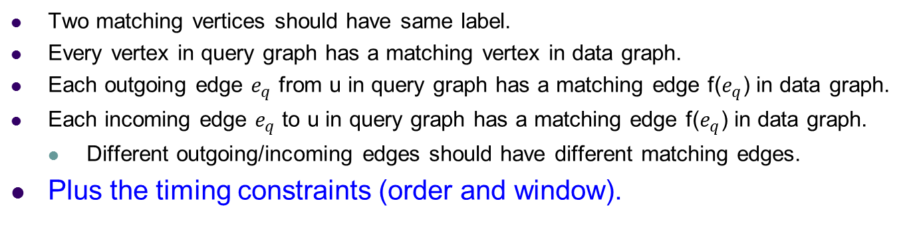
Subgraph structure + Timing
Degree-preserving Dual Simulation:
Two matching vertices should have same label.
Every vertex in query graph has a matching vertex in data graph.
Each outgoing edge $e_{q}$ from u in query graph has a matching edge f($e_{q}$) in data graph.
Each incoming edge $e_{q}$ to u in query graph has a matching edge f($e_{q}$) in data graph.
Different outgoing/incoming edges should have different matching edges.
Plus the timing constraints (order and window).

Slide 21
Outline
Motivation and background
Semantics: what are we doing?
Algorithms: how to do it?

Slide 22
Matching Algorithm
with probability 1/2
with probability 1/2
Uncertain sequence: X = 2|3 2|3 0|1 3 0 0|1 0 2|3 …..
Pattern subsequence: p = 3 0 3 Window size w = 4, prob. threshold = 0.3

Slide 23
Matching Algorithm
with probability 1/2
with probability 1/2
Uncertain sequence: X = 2|3 2|3 0|1 3 0 0|1 0 2|3 …..
Pattern subsequence: p = 3 0 3 Window size w = 4, prob. threshold = 0.3
X
p
2|3
2|3
0|1
3
0
0|1
0
2|3
(0, 1)
(0, 1)
(0, 1)
(0, 1)
(0, 1)
(0, 1)
(0, 1)
(0, 1)
(0, 1)
(1, 1/2)
(2, 1/2)
3
(1, 1/2)
(1, 1)
(2, 1)
(3, 1)
(4, 1)
(1, 1/2)
(2, 1/4)
(3, 1/4)
(2, 1/4)
(3, 1/4)
0
(2, 1)
(3, 1)
(4, 1)
(3, 1/8)
(4, 1/8)
(3, 1/4)
3
(4, 1/8)
(4, 1/4)
window size
prob. of match

Slide 24
Cost of Exact Match Algorithm
X
p
2|3
2|3
0|1
3
0
0|1
0
2|3
(0, 1)
(0, 1)
(0, 1)
(0, 1)
(0, 1)
(0, 1)
(0, 1)
(0, 1)
(0, 1)
(1, 1/2)
(2, 1/2)
3
(1, 1/2)
(1, 1)
(2, 1)
(3, 1)
(4, 1)
(1, 1/2)
(2, 1/4)
(3, 1/4)
(2, 1/4)
(3, 1/4)
0
(2, 1)
(3, 1)
(4, 1)
(3, 1/8)
(4, 1/8)
(3, 1/4)
3
(4, 1/8)
(4, 1/4)
Each cell distribution has at most w pairs; compute one column a time
Time complexity O(|p|*w) per element in the stream
Overall space complexity O(|p|*w)
Expensive if w or |p| is large!

Slide 25
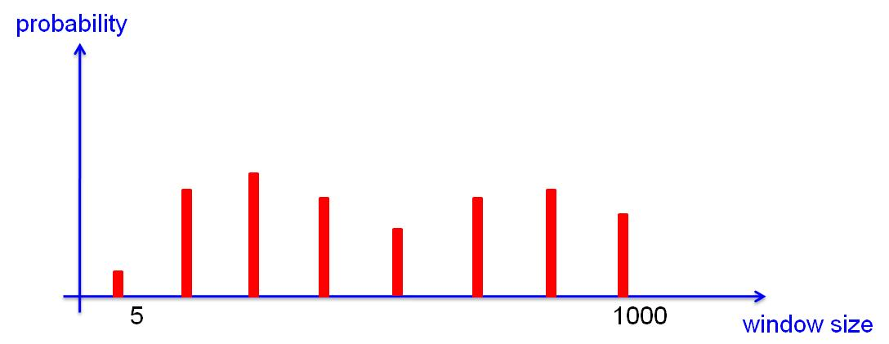
Randomized Algorithm
probability
(
)
5
1000
window size
gap

Slide 26
Randomized Algorithm
probability
(
)
5
1000
window size
gap

Slide 27
Randomized Algorithm
probability
5
1000
window size

Slide 28
Cost after Approximation
X
p
2|3
2|3
0|1
3
0
0|1
0
2|3
(0, 1)
(0, 1)
(0, 1)
(0, 1)
(0, 1)
(0, 1)
(0, 1)
(0, 1)
(0, 1)
(1, 1/2)
(2, 1/2)
3
(1, 1/2)
(1, 1)
(2, 1)
(3, 1)
(4, 1)
(1, 1/2)
(2, 1/4)
(3, 1/4)
(2, 1/4)
(3, 1/4)
0
(2, 1)
(3, 1)
(4, 1)
(3, 1/8)
(4, 1/8)
(3, 1/4)
3
(4, 1/8)
(4, 1/4)
At most O( ) pairs.
Each cell distribution has at most w pairs; compute one column a time
Time complexity O(|p|*w) per element in the stream
Overall space complexity O(|p|*w)
Now reduced to O(|p|* ).

Slide 29
Accuracy Guarantee
Theorem: Using O( ) “bars”, the probability of reporting false positive or false negative for a given match or mismatch can be an arbitrarily small constant.
Each approximation is a step of random walk within (−gap/2, gap/2)
Use Hoeffding’s inequality
probability
Sum of uniform distr. → normal very quickly (Irwin–Hall) – tighter bound
(
)
5
1000
window size
gap

Slide 30
Adaptive Filtering Algorithm
Observation: Often used for monitoring rare events. It is wasteful to pay the full cost of matching whole pattern, just to find mismatch in the end.
Instead, we only match a portion of the pattern, and can almost always filter out mismatches.
X
p
2|3
2|3
0|1
3
0
0|1
0
2|3
(0, 1)
(0, 1)
(0, 1)
(0, 1)
(0, 1)
(0, 1)
(0, 1)
(0, 1)
(0, 1)
(1, 1/2)
(2, 1/2)
3
(1, 1/2)
(1, 1)
(2, 1)
(3, 1)
(4, 1)
(1, 1/2)
(2, 1/4)
(3, 1/4)
(2, 1/4)
(3, 1/4)
0
(2, 1)
(3, 1)
(4, 1)
(3, 1/8)
(4, 1/8)
(3, 1/4)
3
(4, 1/8)
(4, 1/4)

Slide 31
Adaptive Filtering Algorithm
i − w + l₁
i
X
p
a|b
l1
l
C1
l2
l2
w − l
C2
This always saves cost, since the original algorithm computes the whole rectangle, and now we only compute a subset of cells.
The question is: how can we maximize the saving? – by choosing l1 wisely…

Slide 32
Gradient Descent
An optimization technique from the machine learning field
We use it to find the optimal value of parameter l1, so as to maximize the saving of Adaptive Filtering algorithm

Slide 33
Gradient Descent
f
f(x)
guess
gradient
next step
f(m)
x
m

Slide 34

Adaptive Filtering Algorithm
i − w + l₁
i
X
p
a|b
Adaptive to stream content!
l1
l
C1
l2
l2
w − l
C2
Function to minimize: f(l1) – workload as a function of l1 – # of cells actually filled in.
But we don’t even know f(l1). Run once with and then
Estimate the gradient at as

Slide 35
Handling Negations in a Pattern
p = “a x b c”
Basic idea: match with positive character subsequence of p,
but also check forbidden characters in between
p+ = “a b c”, and check if any x between a and b.
w1
w2
w1
a
b
a
X
Recall that we track min matching window sizes for each prefix of p+.
Essentially abort the fresh new matching window w1.

Slide 36
Front and Rear Negations
E.g., match p = 30003 with a window size w
Difference: Need to reach the end of a full window of size w, and do not see “3” after the last matching “0”
Key idea: fork a new matching instance M at each start of a window. M has a life time of w steps.
Observation: at most w concurrent matching instances. Thus, complexity is increased by a factor of w at most.

Slide 37
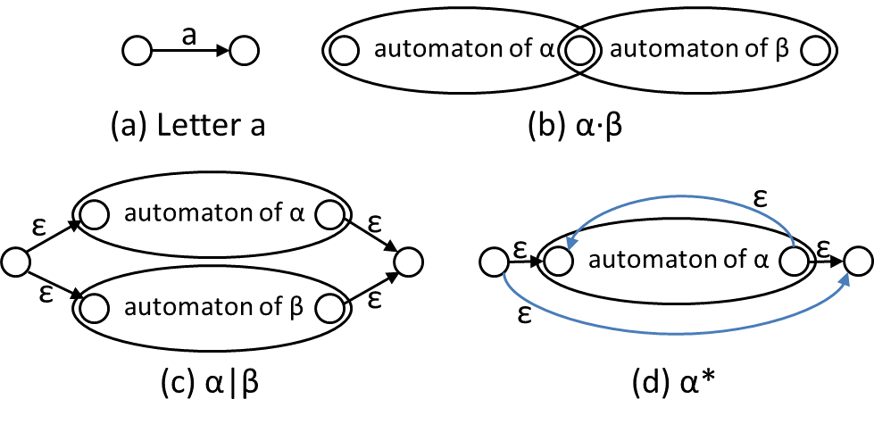
Thompson’s Automaton
Notes:
Next preliminary is Tompson’s Automaton, which is a non-deterministic automaton. It accepts languages represented by a regular expression.
The figure illustrate the construction of TA.
(a) An elementary letter has a start and a final state. (b) Concatenation: α’s final state merges with β’s start state. (c) Or, α|β: create new start and final states and put \alpha and \beta ‘s automata in parallel. (d) Kleene star, α*: create new start and final states and add these \epsilon(in-deterministic) transitions; note the new forward and back edges.
Illustrating the construction of Thompson’s automaton(which is a non-deterministic automaton accepting the language of a given regular expression).

Slide 38
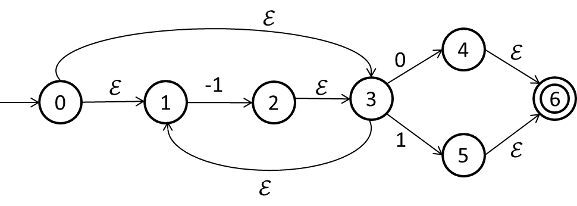
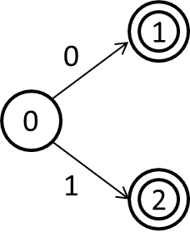

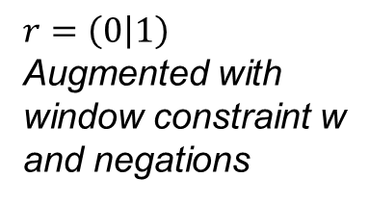


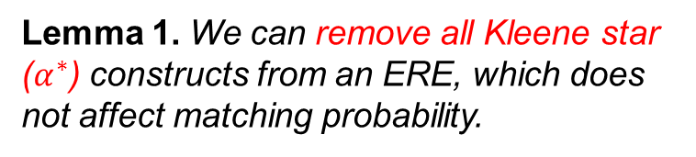
Augmented Thompson’s Automaton
Lemma 1. We can remove all Kleene star ($α^{∗}$) constructs from an ERE, which does not affect matching probability.
$$r=\left(0 | 1\right)$$
Augmented with
window constraint w
and negations
$$r=−1^{∗}(0|1)$$
$$L state$$
$$ℰ state$$
Notes:
We introduce ATA to represent our ERE which is introduced in the previous slide.
Let’s look at an example. We have this regular expression r, with a kleene star on -1. We can remove the kleene star in the equivalent ERE is 0/1 augmented with window constraint and negations if it’s needed. And it will not affect the matching prob because we allow mixing in irrelevant letters. In addition it’s augmented with window constraint and negations, which will be discussed later.
With this lemma, we can also transform the TA to an ATA. In TA we call states with only \epsion in edges \epsilon state, and we call the others L state. We’ll be using the augmented ta in our matching algorithm.
L state and \epsilon state
an L-state, which has only one incoming edge with a letter on it, and (2) an $ε$-state, which has one or more incoming edges, all having a label $ε$

Slide 39
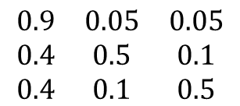
An Error Model
-1 0 1 -1……
sequence
r = -1(0|1)
0
2
1
2
3
-1
1
0
1
$$\begin{matrix}0.9 & 0.05 & 0.05 \\ 0.4 & 0.5 & 0.1 \\ 0.4 & 0.1 & 0.5\end{matrix}$$
2
P
1
3
3
Level 1: no error
Level 2: positive error
Level 3: negative error
Error Model
To match a state, what error do we have to assume?
Notes:
There has been previous work on pattern matching over noisy streams/sequences.
Most previous work will first learn a probabilistic distribution of the sequence stream and then process queries over the distributions.
In this work, we resort to an error model to model noise in the stream Then we devise matching algorithms using tompson’s automata to detect matching paths with significant probability. This model is learned offline and is more stable than the dynamic data stream itself. These matching paths provide a lineage for users to trace back the basic events tuples in the stream .
One advantage of using an error model is that sta infer is extremly fast at run time. We just look up a error transition matrix
In sharp contrast to the typical assumption of using machine learning techniques to learn a joint distribution of the stream first and then perform query processing, we only need to know the error model, which, as we have discussed, is much more stable than the dynamic stream. Different powers of the transition matrix $P^{α}$ can be pre-computed ($α≤w$). Probabilistic inference is extremely fast at runtime – we just look up a matrix.
Our Proposal: resort to an error model which is learned offline and is more stable than the dynamic data stream. In real time, our algorithm returns all matching paths with significant probabilities. These matching paths provide a lineage for users to trace back the basic events and tuples in the stream that cause the match.

Slide 40
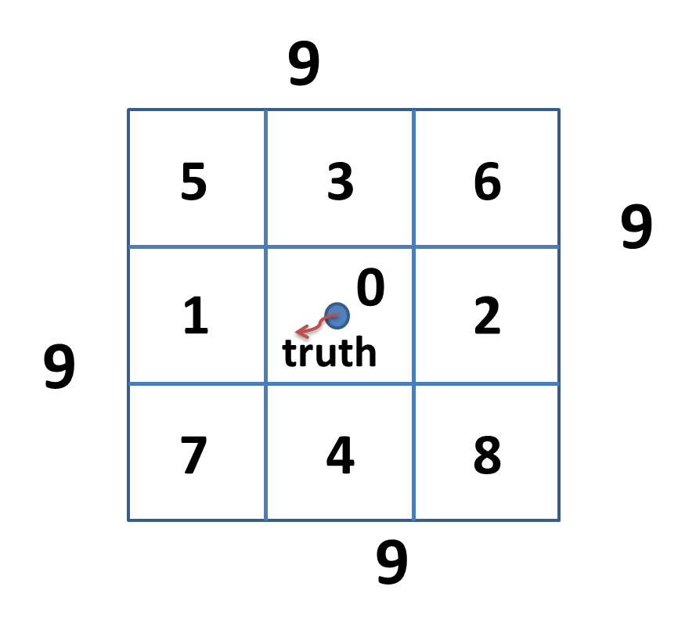
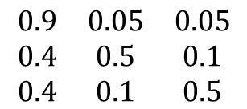
2-D Error Model: Shopping Mall
0
1
2
. . .
9
0
$$\begin{matrix}0.9 & 0.05 & 0.05 \\ 0.4 & 0.5 & 0.1 \\ 0.4 & 0.1 & 0.5\end{matrix}$$
1
2
P
:
.
.
.
9
2D case
Notes:
We use Markov chain error models in this work, however our algorithms work with any error model.
To get a markov chain error model, we first define error levels, for example for numerical values, we say error being 0 is level 1, error being 1 is error level 2 and error being -1 is level 3.
Then we learn a transition matrix for the defined error levels from the training data.
This process also applies to multi dimensional data, for example, estimated locations from GPS are 2 d data. We define error levels as in the figure on the rightside and learn a transition matrix from training data. The advantages of Markov chain error model: 1. it’s relatively stable, 2. it catches local positive correlation of errors, 3. probability inference is extremely fast.
Our $ℰ$-Matching algorithms can work with any error model $ℰ$, which describes a joint distribution of the errors at each character of the sequence. The simplest error model is that each character’s error is independently distributed. However, as discussed in Section 1.1, errors in data streams are often naturally correlated. As we have verified in our experiments using real world data (Section 7), using an independent error model can make the matching probability two or more orders of magnitude smaller than a Markov chain error model, which makes true occurrence of a pattern in the stream indiscernible from mismatching sequences.
In this work, we use Markov chain error models by default,

Slide 41





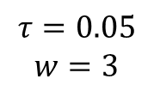


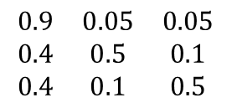
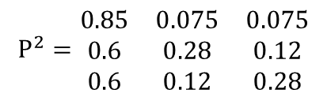




$ℰ$-Matching Algorithm
sequence
-1 0 1 -1……
state
-1
0
1
-1
sequence
(1, 0.8)
(2, 0.1)
(4, 0.8)
1
$e=0$
$e=1$
$e=0$
r = -1(0|1)
0
2
(2, 0.8*0.9)
(3, 0.8*0.075)
(4, 0.1*0.12)
0
-1
1
2
$e=0$
(3, 0.1*0.5)
$e=−1$
$e=1$
1
(2, 0.8*0.05)
(3, 0.8*0.85)
3
3
(3, 0.1*0.4)
$e=−1$
$e=0$
1
2
3
1
$$\begin{matrix}0.9 & 0.05 & 0.05 \\ 0.4 & 0.5 & 0.1 \\ 0.4 & 0.1 & 0.5\end{matrix}$$
$$P^{2}=\begin{matrix}0.85 & 0.075 & 0.075 \\ 0.6 & 0.28 & 0.12 \\ 0.6 & 0.12 & 0.28\end{matrix}$$
2
$$\overset{⃑}{λ}=(0.8, 0.1, 0.1)$$
$$τ=0.05$$
$$w=3$$
$P$
3
Notes:
Let’s look at an example:
In the left, we show the sequence , pattern and the corresponding augemented tompson’s automaton.
Suppose we have learned the error transition matrix P. We also compute the 2 step transition matrix p^2. and stationary distribution \lamda, prob threshold 0.05 and window constraint is 3.
Our algo works progressively as the sequence streams in. When the first letter -1 comes, we keep the partial path at state 1. The prob of matching 0.8 is from the stationary distribution because we have no prior matching history so we use the marginal probability of error being 0. When the next letter 0 comes, we records it at state 1 with prob .1. In addition, we try to bring the old partial path one step forward. So we bring the old partial path at state 1 to state 2, the error would be 0 again, and we use error transition prob P11 error remains 0 which is level 1. So we multiply prob. by 0.9, thus we end up with prob 0.8*0.9. Because state 2 is the final state and the prob of matching is significant, we report a matching here. As you see, we also have the lineage info of the matching so we are able to trace back to those basic events that triggered the matching. At state 3, error would be -1, we look up P_1,3, the transition prob of level 1 to level 3. which is 0.05. The prob drops below 0.05 and we can get rid of this path.
Big idea and example
maintain a list of partial matching paths that end at state $i$, Since we record $j$, when we bring a path forward, we know how many characters (say, $α$) in stream we are skipping; then $P^{α}$ is used to look up the transition probability.

Slide 42

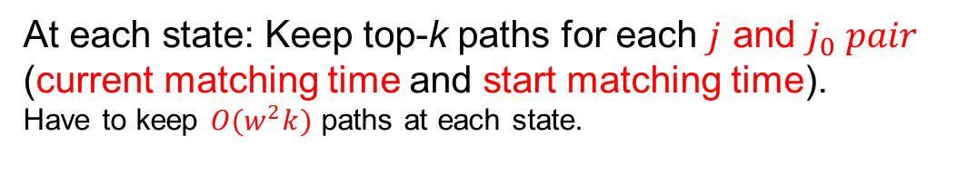
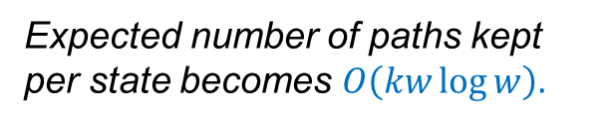
Top-K $𝓔$-Matching Algorithm
At each state: Keep top-k paths for each $j$ and $j_{0} pair$ (current matching time and start matching time).
Have to keep $O(w^{2}k)$ paths at each state.
j*-3
j*-2
j*-1
j*
j
stream
additions to top-k
Contains matches up to state i
additions to top-k
additions to top-k
Expected number of paths kept per state becomes $O\left(kw\log{w}\right).$
top-k starting from j* or later
Notes:
The correct approach is to keep topk paths for each j and j0 pair at each state. Where j0 is the first matching time of a path and j is the current matching time. If we do this, we end up storing O of w^2k paths each state. Because both j and j0 is bounded by w. Yet, the result can still be improved.
The idea is simple, because newer path gets expired later. So we pick paths in starting time reverse order, let’s assume at j*, we have k paths starting from j* or later. This makes sure we always have k paths in a future time. Then for each starting time older than j*, we only keep those paths that will make into topk in addition to the paths we already have. This approach makes the expected number of paths kept at each state to be O of kwlogw. We formally prove it in the paper using harmonic series.
The intuition is that paths with newer first matching time j0 gets expired later, so we first keep the newest top-k to make sure we will always have enough k paths in the future. So consider first matching time j0 in reverse order, assume at j* we have top-k paths with starting time from j* or later.

Slide 43
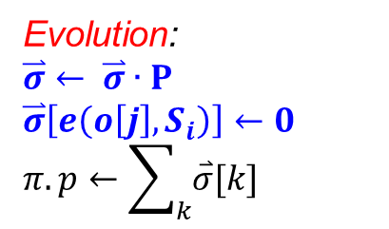
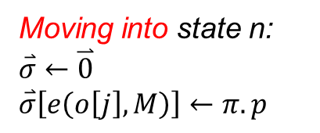
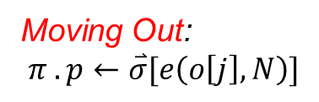
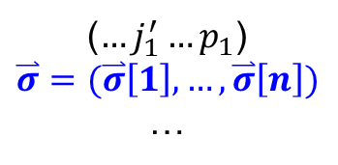

Negations
$$r=M\left(\overline{S_{1}}\overline{S_{2}}\overline{S_{3}}\right)N$$
0
M
n
N
1
Front and rear negation can be handled with some modifications.
($…j_{1}^{′}…p_{1}$)
$$\overset{⃑}{σ}=(\overset{⃑}{σ}\left[1\right], …, \overset{⃑}{σ}\left[n\right])$$
…
Moving into state n:
$$\overset{⃑}{σ}←\overset{⃑}{0}$$
$$\overset{⃑}{σ}\left[e\left(o\left[j\right], M\right)\right]←π.p$$
Moving Out:
$$π .p←\overset{⃑}{σ}[e\left(o\left[j\right], N\right)]$$
Evolution:
$$\overset{⃑}{σ}← \overset{⃑}{σ}∙P$$
$$\overset{⃑}{σ}\left[e\left(o\left[j\right], S_{i}\right)\right]←0$$
$$π.p←\sum_{k}{\overset{⃑}{σ}[k]}$$
Notes:
Let’s see an example.
r is an extended regular expression with surrounded negations S1 S2 S3, which means s1 s2 s3 are forbidden betweeen m and n. We create a state n for these three neighboring negations. In addition to the other path info we had before, we keep an error level distribution vector \delta at state n. Let me explain how to use \delta.
Moving into state n, we initialize delta to be a 0 vector, we know the current error level is e(o[j],M), we update the corresponding element of \delta to be the prob of this path. Rember \delta is the erorr level distribution vector
At state n: we evolve \delta for each letter in the stream. First multiply transition matrix P, then setting the elements in delta which corresponds to matching of negation characters to be 0. These elements are \delta e(o[j],si). At last, we update the prob of this path to be the summation of elements in \delta
When moving out of state n, we pick the element in \delta that corresponds to matching captal N and make it the prob of the path.

Slide 44
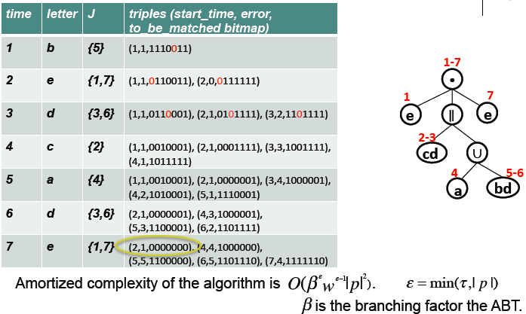
Parallel, Interleaving Events

Slide 45
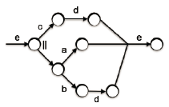
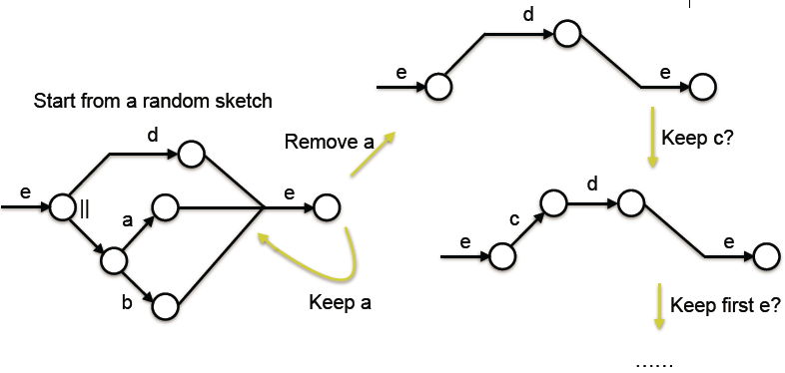
Optimization: Automaton Sketch
First run a smaller and more efficient version of the automaton, which we call a sketch.
Run the full version automaton to verify it only when there is a match for the sketch.

Slide 46
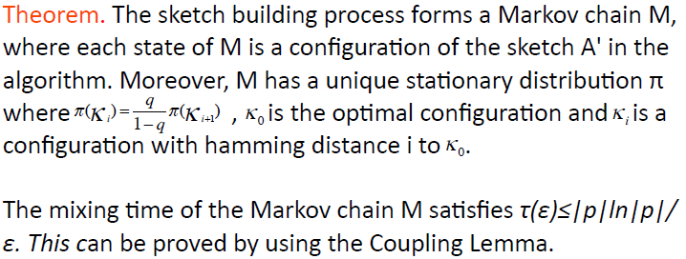
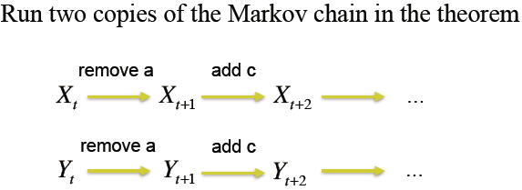
Theoretical Foundation

Slide 47
Subgraph structure + timing patterns
Number Theoretic Signature Method
Try to encode graph structure information into a concise signature.
Information of nodes, edges, or node degrees.
Edge factors: encodes label match of the edge and two endpoints.
Degree factors: designed for degree preservation.
If the signature is too large, break it into several small pieces.

Slide 48
Number Theoretic Signature Method
0
For each vertex and edge label value, assign a random value in [0,p), suppose p=17
1
2
2
1
L
0
1
2
3
1
2
2
r
9
3
14
6
16
7
0
1
3
2
Offline: Compute query graph signature
Go through each edge: (9-3+16)*(6-9+16)*(9-14+7)=130
Compute degree factor:
0: (9+1)(9-1)(9-2)=560
1: (3+1)=4
3: (6-1)=5
2: (14+1)=15
$σ:130∗560∗4∗5∗15=21,840,000$
Online:
$σ_{e}$ : (9-14+7) mod 17 =2
$σ_{u} :$ (9-1) mod 17 =8
$σ_{v}$ : (14+1) mod 17 =15
s : 2*8*15 mod $σ$ = 240

Slide 49
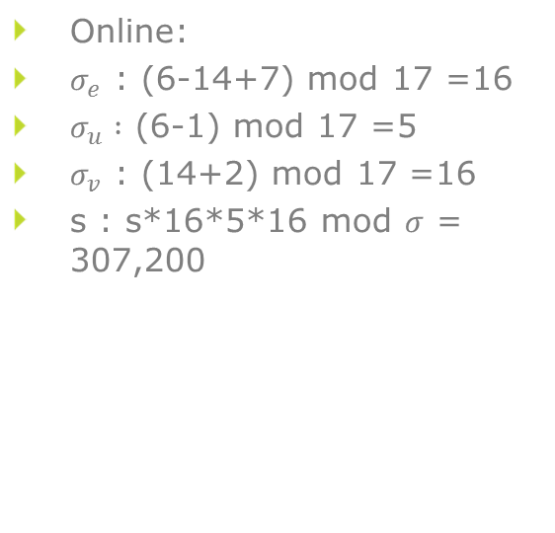
Number Theoretic Signature Method
0
For each vertex and edge label value, assign a random value in [0,p), suppose p=17
2
1
2
//
1
L
0
1
2
3
1
2
2
2
r
9
3
14
6
16
7
3
0
1
3
2
Offline: Compute query graph signature
Go through each edge: (9-3+16)*(6-9+16)*(9-14+7)=130
Compute degree factor:
0: (9+1)(9-1)(9-2)=560
1: (3+1)=4
3: (6-1)=5
2: (14+1)=15
$σ:130∗560∗4∗5∗15=21,840,000$
Online:
$σ_{e}$ : (6-14+7) mod 17 =16
$σ_{u} :$ (6-1) mod 17 =5
$σ_{v}$ : (14+2) mod 17 =16
s : s*16*5*16 mod $σ$ = 307,200

Slide 50
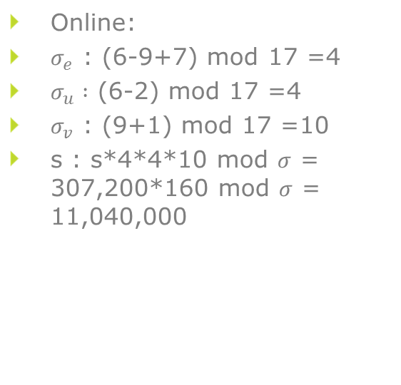
Number Theoretic Signature Method
0
For each vertex and edge label value, assign a random value in [0,p), suppose p=17
2
1
2
//
1
L
0
1
2
3
1
2
2
2
r
9
3
14
6
16
7
3
0
1
3
2
2
Offline: Compute query graph signature
Go through each edge: (9-3+16)*(6-9+16)*(9-14+7)=130
Compute degree factor:
0: (9+1)(9-1)(9-2)=560
1: (3+1)=4
3: (6-1)=5
2: (14+1)=15
$σ:130∗560∗4∗5∗15=21,840,000$
Online:
$σ_{e}$ : (6-9+7) mod 17 =4
$σ_{u} :$ (6-2) mod 17 =4
$σ_{v}$ : (9+1) mod 17 =10
s : s*4*4*10 mod $σ$ = 307,200*160 mod $σ$ = 11,040,000

Slide 51
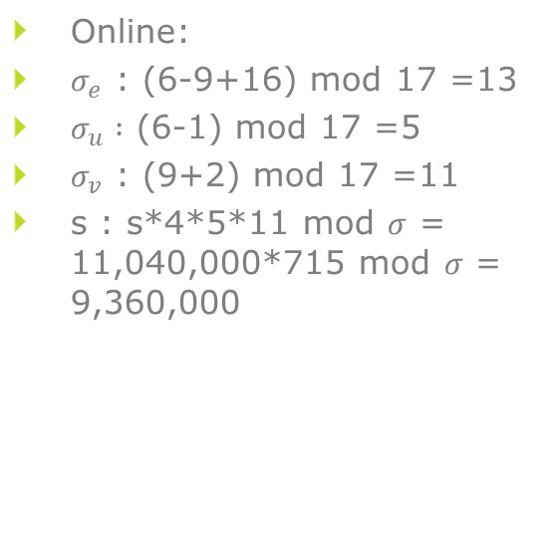
Number Theoretic Signature Method
0
For each vertex and edge label value, assign a random value in [0,p), suppose p=17
2
1
2
//
1
L
0
1
2
3
1
2
2
2
3
0
1
3
2
r
9
3
14
6
16
7
2
1
Offline: Compute query graph signature
Go through each edge: (9-3+16)*(6-9+16)*(9-14+7)=130
Compute degree factor:
0: (9+1)(9-1)(9-2)=560
1: (3+1)=4
3: (6-1)=5
2: (14+1)=15
$σ:130∗560∗4∗5∗15=21,840,000$
3
Online:
$σ_{e}$ : (6-9+16) mod 17 =13
$σ_{u} :$ (6-1) mod 17 =5
$σ_{v}$ : (9+2) mod 17 =11
s : s*4*5*11 mod $σ$ = 11,040,000*715 mod $σ$ = 9,360,000

Slide 52
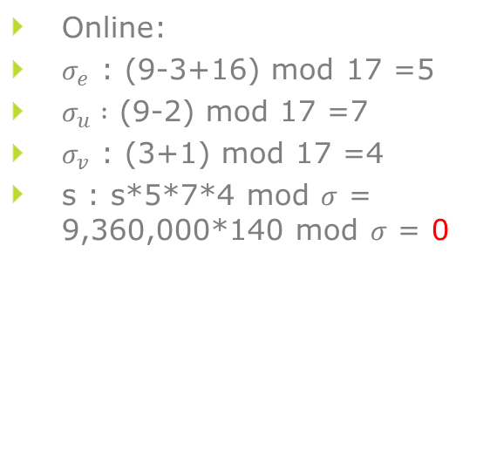
Number Theoretic Signature Method
0
For each vertex and edge label value, assign a random value in [0,p), suppose p=17
2
1
2
//
1
L
0
1
2
3
1
2
2
2
3
0
1
1
3
2
r
9
3
14
6
16
7
2
1
1
Offline: Compute query graph signature
Go through each edge: (9-3+16)*(6-9+16)*(9-14+7)=130
Compute degree factor:
0: (9+1)(9-1)(9-2)=560
1: (3+1)=4
3: (6-1)=5
2: (14+1)=15
$σ:130∗560∗4∗5∗15=21,840,000$
3
Online:
$σ_{e}$ : (9-3+16) mod 17 =5
$σ_{u} :$ (9-2) mod 17 =7
$σ_{v}$ : (3+1) mod 17 =4
s : s*5*7*4 mod $σ$ = 9,360,000*140 mod $σ$ = 0
When there’s a signature match, run baseline solution for the last window to verify if it’s a true match.

Slide 53
Coloring Algorithm
An incoming edge is colored black if it matches some edge in query graph.
An incoming edge is further colored red if all of this edge's adjacent edges also match to distinct edges.
When we have a red edge component that contains all edges in query graph, we verify if we have a true match.
We maintain a countMap to see whether the red component is large enough.

Slide 54
Coloring Algorithm
B
1
D
1
B
A
1
A
1
A
2
2
E
C

Slide 55
Coloring Algorithm
B
1
D
1
1
B
A
E
1
A
1
A
2
2
E
C

Slide 56
Coloring Algorithm
B
1
D
1
1
B
A
E
1
2
A
1
A
C
2
2
E
C

Slide 57
Coloring Algorithm
B
1
D
1
1
1
B
D
A
A
E
1
2
A
1
A
C
2
2
E
C

Slide 58
Coloring Algorithm
B
1
D
1
1
1
B
D
A
A
E
1
2
2
A
1
A
C
B
2
2
E
C

Slide 59
Coloring Algorithm
B
1
D
1
1
1
B
D
A
A
E
1
2
2
A
1
A
1
B
C
2
2
A
E
C
Red Component: (AB, AC)
Master Edge: (AB)
countMap: (AB 1, AC 1, AA 0, AD 0, AE 0)

Slide 60
Coloring Algorithm
B
1
D
1
1
1
B
D
A
A
E
1
2
2
A
1
A
1
B
1
C
2
2
A
A
E
C
Red Component: (AB, AC)
Master Edge: (AB)
countMap: (AB 1, AC 1, AA 0, AD 0, AE 0)

Slide 61
Coloring Algorithm
E
B
2
1
D
1
1
1
B
D
A
A
E
1
2
2
A
1
A
1
B
1
C
2
2
A
A
E
C
Red Component: (AB, AC)
Master Edge: (AB)
countMap: (AB 1, AC 1, AA 0, AD 0, AE 0)
Red Component: (AD, AE)
Master Edge: (AD)
countMap: (AB 0, AC 0, AA 0, AD 1, AE 1)

Slide 62
Coloring Algorithm
E
B
2
1
D
1
1
1
1
B
D
A
A
E
1
2
2
A
1
A
1
B
1
C
2
2
A
A
E
C
Red Component: (AB, AC, AA, AD, AE)
Master Edge: (AB)
countMap: (AB 1, AC 1, AA 1, AD 1, AE 1)

Slide 63
Coloring Algorithm – Verify Match
Check time constraints.
Check if "the neighbors of red edges are all red"
If fails at some red edge, then remove it from match set, backtrack to possibly remove from other red edges.
Repeat until there are no changes.
Coloring algorithm: The amortized cost per incoming edge is O(1).

Slide 64
Conclusions
Sequence data has many faces – such data is everywhere and applications are prevalent.
Pattern matching a.k.a. complex event processing is a useful analysis operation with many semantics “faces”.
Algorithmic solutions have many facets.

Slide 65
References
Zheng Li, Tingjian Ge. Online Windowed Subsequence Matching over Probabilistic Sequences. In the Proceedings of the ACM SIGMOD International Conference on Management of Data (SIGMOD 2012) , Scottsdale, Arizona, USA, May 2012.
Zheng Li, Tingjian Ge, Cindy X. Chen. E-Matching: Event Processing over Noisy Sequences in Real Time. In the Proceedings of the ACM SIGMOD International Conference on Management of Data (SIGMOD 2013) , New York, New York, USA, June 2013.
Zheng Li, Tingjian Ge. PIE: Approximate Interleaving Event Matching over Sequences. In the Proceedings of the IEEE 31st International Conference on Data Engineering (ICDE 2015) , Seoul, Korea, April 2015.
Chunyao Song, Tingjian Ge, Cindy Chen, Jie Wang. Event Pattern Matching over Graph Streams. In the Proceedings of the VLDB Endowment, Volume 8, Issue 4, and the 41st International Conference on Very Large Data Bases (VLDB 2015), Kohala Coast, Hawai'i, August 2015.

Slide 66
Thank you.

